Slide 1
Final Project Documentation
Purchase Pattern Analysis using Market Basket Analysis
Project Id : CDACL005 (Client Project)
Project Team ID : PTID-CDA-DEC-25-958
Members:
Ankit Raj Sinha
Lolla Venkata Surya Sudheer Kumar
Gangula Padma

Slide 2
Project Overview
Project Title: Purchase Pattern Analysis
Project Objective:
The objective of this project is to analyze customer purchasing behavior using transactional retail data and identify hidden product relationships. The project aims to discover frequently purchased product combinations and generate actionable insights that support cross-selling, inventory optimization, and data-driven business decision-making.
Business Problem Statement:
Retail businesses often struggle to understand which products are purchased together. Without data-driven insights, cross-selling opportunities, store layout planning, and promotional strategies remain inefficient. This project addresses the challenge by applying Market Basket Analysis to uncover strong product associations and improve revenue performance.

Slide 3
Dataset Description
Approximately 500,000 transaction records
Time Period: 2010–2011
Features:
BillNo
ItemName
Quantity
Price
CustomerId
Country
InvoiceDate

Slide 4
Data Cleaning & Preprocessing
Data Cleaning Steps:
Removed transactions with negative quantities (returns)
Removed cancelled invoices (starting with 'C’)
Dropped records with missing ItemName
Product Filtering:
Selected Top 500 most frequently purchased products
Removed single-item transactions to improve association rule quality
Data Transformation:
Created Transaction–Product Matrix
Converted quantity matrix into Binary Basket Matrix (1 = Purchased, 0 = Not Purchased)
This transformation was required for Apriori algorithm implementation.

Slide 5
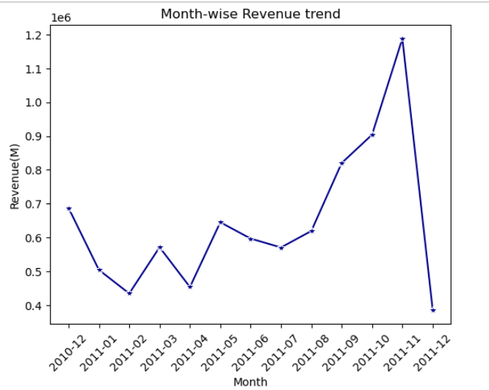
Exploratory Data Analysis (EDA)
Monthly Revenue Trend
Insights:
From the month of January to May there is inconsistent customer purchasing behavior due to absence of Strong seasonal demand.
A clear upward growth trend from August to November, this growth corresponds to Festive and Holiday seasons.
November records the highest revenue, indicating peak seasonal demand.
Sharp decline in the month of December immediately after a high peak in November shows that customer already spend heavy in the festive season.

Slide 6
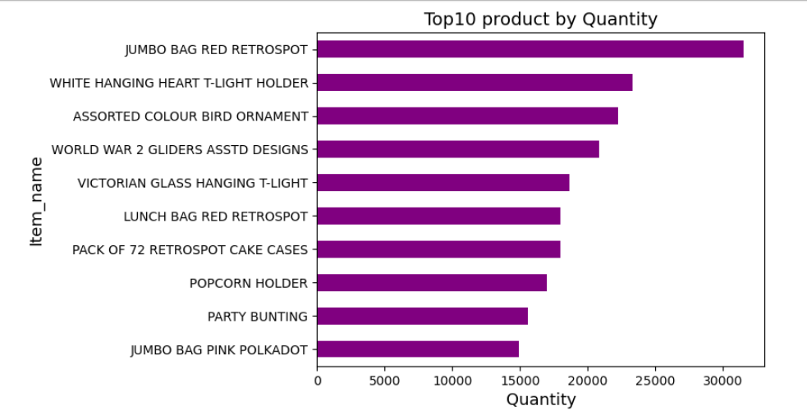
Top 10 product by quantity
Insights:
JUMBO BAG RED RETROSPOT is the highest selling product, indicating very strong purchase demand.
It is followed by WHITE HANGING HEART T-LIGHT HOLDER and ASSORTED COLOUR BIRD ORNAMENT.
These top-selling products should be prioritized for inventory stocking.

Slide 7
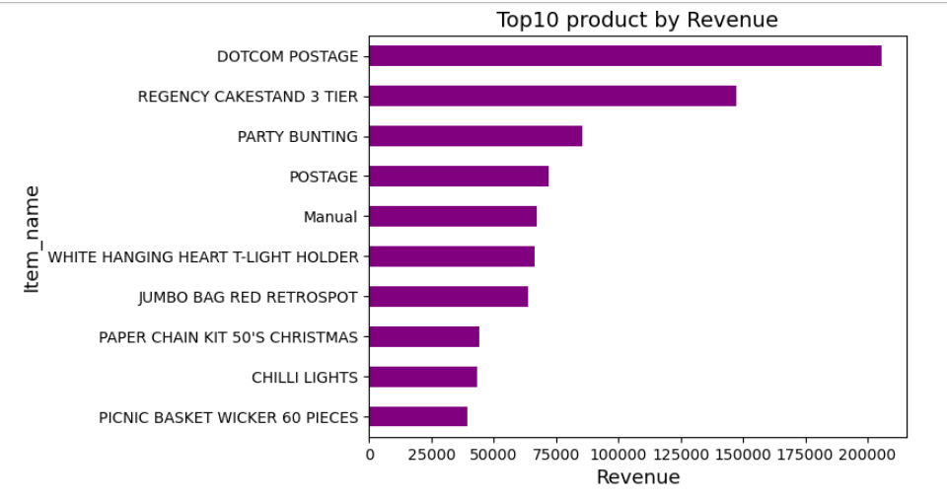
Top 10 product by revenue
Insights:
DOTCOM POSTAGE is the highest revenue generating item followed by REGENCY CAKESTAND 3 TIER and PARTY BUNTING.
By comparing revenue and quantity, different products rank at the top. This indicates that despite lower sales volume, certain products contribute significantly to overall revenue due to higher unit prices.

Slide 8
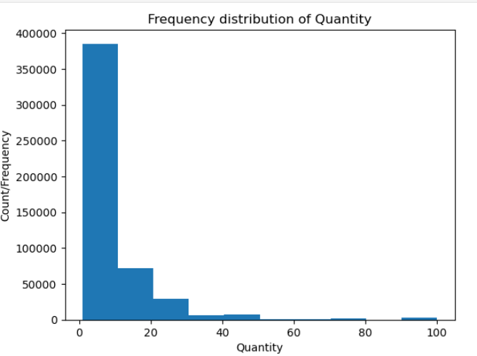
Quantity distribution
Insights:
The distribution is Right Skewed, indicating that most transactions involve low quantity purchase.
Majority of orders fall in the 1-10 quantity range, showing customers usually buy items in small numbers.
High quantity orders are rare, but still present, indicating bulk or wholesale purchase by a small set of customers.

Slide 9
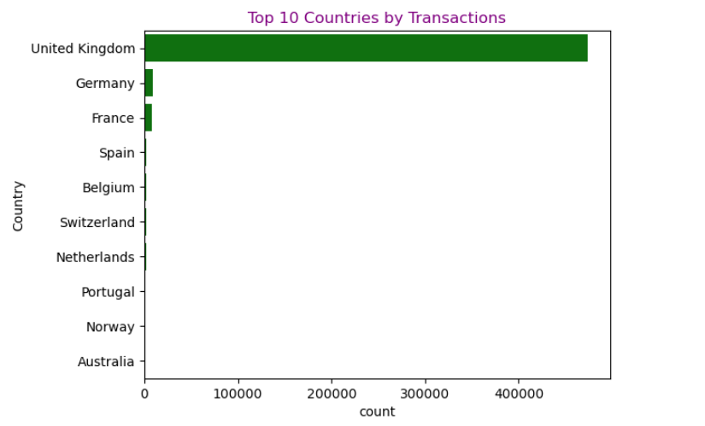
Country-wise Sales
Insights:
The transactions are highly UK centric, indicating business operations are primarily focused on UK market.
There is also a risk factor that the whole business depends on a single country market.

Slide 10
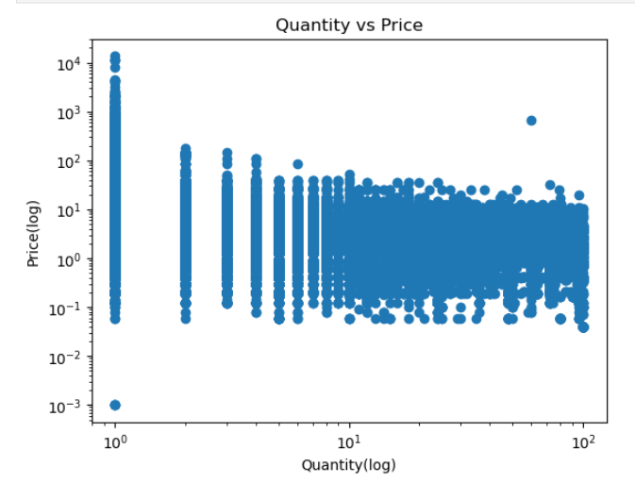
Quantity vs Unit Price Distribution
Insights:
Relationship between Quantity and Price shows inverse trend, as Price increases Quantity decreases.
Customers usually buy less quantity of item of higher price.
When the price falls in the low-to-medium range, customers tend to purchase higher quantities.

Slide 11
EDA Summary / Key findings
Sales and transactions are highly concentrated in the UK
market.
Majority of customers purchase items in small quantities.
Few products contribute significantly to overall revenue.
Presence of outliers due to bulk purchases.

Slide 12
Market Basket Analysis (Apriori Implementation)
Algorithm Used : Apriori Algorithm
Technical Parameters :
min_support = 0.004
confidence ≥ 0.6
lift ≥ 1.9
Top 500 products considered
Results :
28 strong association rules identified
High lift values indicate strong cross-selling potential

Slide 13
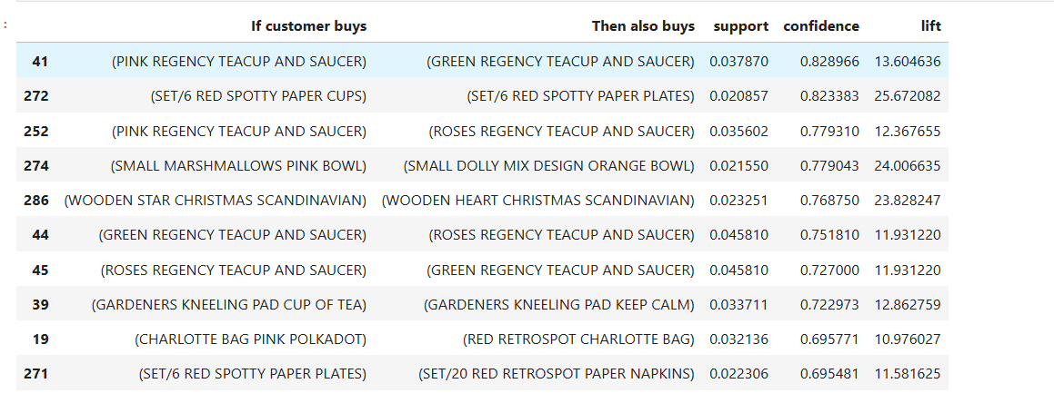
Frequent Itemset Identified
Table of Top Frequent Itemset:
Insights:
Customers often buy matching or same-theme products together, showing strong category-level associations.
High lift values (>10) indicate strong cross-selling opportunities, especially in decorative and gifting items.

Slide 14
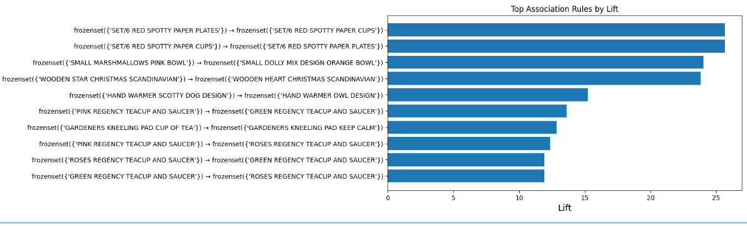
Lift Visualization
Horizontal Bar Chart of Top 10 Rules by Lift
Insights:
Product pairs with high lift values indicate a strong likelihood of being purchased together compared to random chance.
SET/6 Red Spotty Paper Plates and SET/6 Red Spotty Paper Cups show the highest lift, suggesting a strong complementary relationship.
Such high-lift product combinations can be effectively used for bundle offers, cross-selling, and store layout optimization.

Slide 15
Key Association Insights
Strong complementary relationships between party decoration items.
Themed product combinations frequently purchased together
Certain product pairs significantly increase basket size
High-lift product combinations present strong bundling opportunities

Slide 16
Business Recommendations
Bundle high-lift product combinations
Optimize physical store layout based on product associations
Implement cross-selling recommendations in e-commerce platforms
Introduce combo discounts for complementary products
Expand geographically to reduce market concentration risk

Slide 17
Expected Business Impact
Increase in Average Order Value (AOV)
Improved cross-selling performance
Better inventory planning
Enhanced customer shopping experience
Data-driven merchandising strategy

Slide 18
Conclusion
This project successfully analyzed retail transaction data to identify meaningful customer purchase patterns. Through structured data cleaning, exploratory analysis, and implementation of the Apriori algorithm, strong product associations were discovered.
The results highlight clear cross-selling and bundling opportunities that can improve average order value and overall revenue. The findings also support better inventory planning and data-driven merchandising decisions.
Overall, the project demonstrates how Market Basket Analysis can transform raw transaction data into actionable business insights that directly support strategic growth and operational efficiency.

Slide 19
GitHub Repository
The complete project implementation, including data preprocessing scripts,
Apriori algorithm implementation, and visualization code, is available at:
🔗 GitHub Repository:
Repository Link : LINK (Click on the link to see the GitHub Repository)

